Slide 1
Danny’s Diner Data Analysis
#8WeeksSQLChallenge

Slide 2
Danny’s Diner: Introduction
Add your first bullet point here
Add your second bullet point here
Add your third bullet point here

Slide 3
Entity Relationship Diagram
Table
Member
Menu
Sales
First bullet point here
Second bullet point here
Third bullet point here

Slide 4
Title and Content Layout with Chart

Slide 5
Two Content Layout with Table
First bullet point here
Second bullet point here
Third bullet point here
Class | Group A | Group B
Class 1 | 82 | 95
Class 2 | 76 | 88
Class 3 | 84 | 90

Slide 6
Q1
What is the total amount each customer spent at the restaurant?

Slide 7
Q2
How many days has each customer visited the restaurant?

Slide 8
Q3
What was the first item from the menu purchased by each customer?

Slide 9
Q4
What is the most purchased item on the menu and how many times was it purchased by all customers?

Slide 10
Q5
Which item was the most popular for each customer?

Slide 11
Q6
Which item was purchased first by the customer after they became a member?

Slide 12
Q7
Which item was purchased just before the customer became a member?

Slide 13
Q8
What is the total items and amount spent for each member before they became a member?

Slide 14
Q9
If each $1 spent equates to 10 points and sushi has a 2x points multiplier - how many points would each customer have?

Slide 15
Q10
In the first week after a customer joins the program (including their join date) they earn 2x points on all items, not just sushi - how many points do customer A and B have at the end of January?

Slide 16
Add a Slide Title - 2

Slide 17
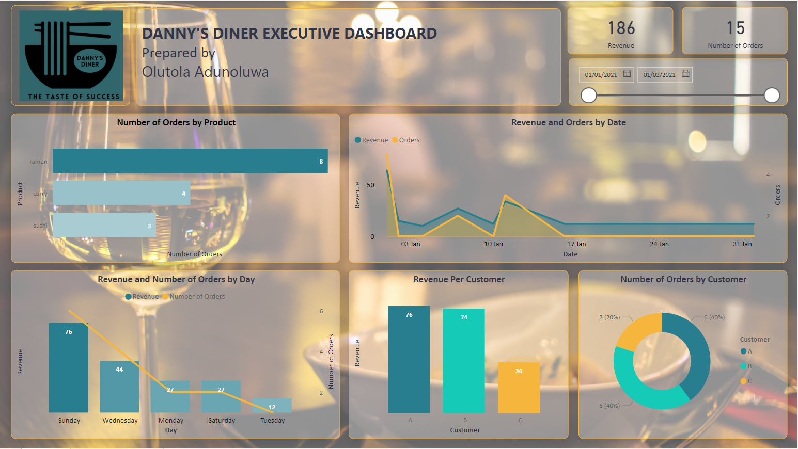
Dashboards

Slide 19
Add a Slide Title - 4

Slide 20
Add a Slide Title - 5

